Slide 1
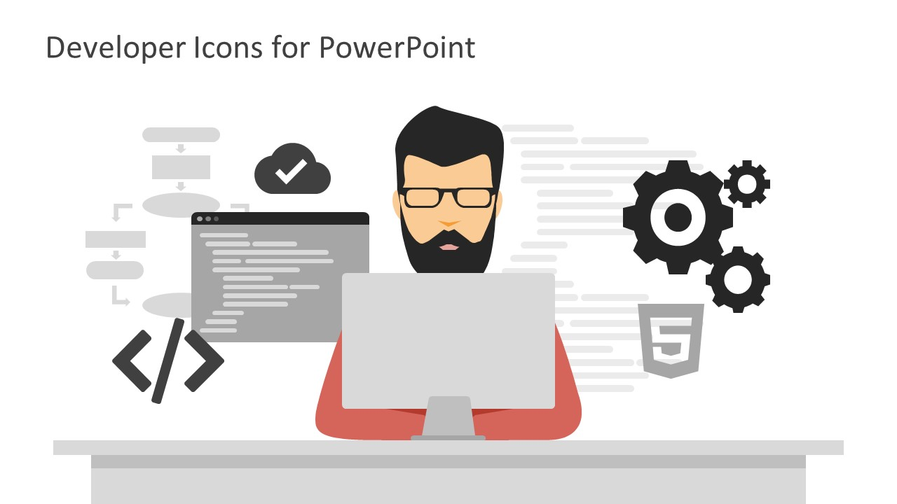
Web-Development

Slide 2
Introduction
What is Web-development ?
Web development is the building and maintenance of websites; it's the work that happens behind the scenes to make a website look great, work fast and perform well with a seamless user experience. Web developers, or 'devs', do this by using a variety of coding and markup languages.
Need Of Web-development
Web development is the work involved in developing a Web site for the Internet (World Wide Web) or an intranet (a private network).Web development may use content management systems (CMS) to make content changes easier and available with basic technical skills.

Slide 3
Objective
To gain skills and knowledge about various Web-development concepts.
To see what skills and knowledge does students still need to work in professional environment.
Experience designing and programming web pages.
To learn languages and frameworks used for creating and developing the websites .
To build various web-development based things like websites and web applications.

Slide 4
Introduction To Organization
Envision Computer Training Institute (ECTI), established in 1999 in Pune, Maharashtra, is a top player in the category Computer Training Institutes in the Pune.
The company offers job oriented courses with 100% guaranteed placement.
ECTI corporate trainings to freshers or newly joined students.
Also the new technologies are taught to students in practical oriented.
The institute environment is very good as the staff is well balanced.

Slide 5
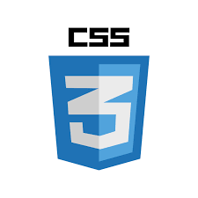
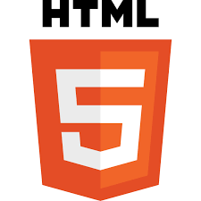

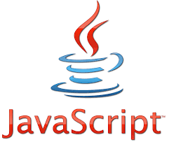
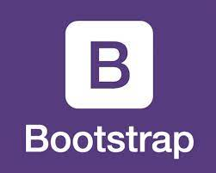
Languages Learnt
HTML (Hypertext Markup Language)
CSS (Cascading Style Sheets)
Bootstrap
JavaScript
jQuery

Slide 6
HTML
HTML is a markup language & not a programming language.
HTML can be used to create your own websites.
HTML is used to describe the structure of web pages.
HTML uses different tags such as <html>,<p>,<head>,<body>,<div> etc

Slide 7
CSS
CSS is a language we use to style a HTML document
CSS describes how HTML elements should be displayed.
CSS control the layout of multiple web pages all at once.
Types of CSS -: Inline CSS, Internal CSS & External CSS.

Slide 8
Bootstrap
Bootstrap is the most popular framework for creating responsive
websites.
Bootstrap is free front-end framework.
Bootstrap includes various templates such as buttons, grid system,
table, navigation for HTML & CSS.
Bootstrap is used to make responsive websites that can be adjustable on any device.

Slide 9
JavaScript
JavaScript is used to make interactive web pages.
JavaScript is used for manipulation by using DOM, BOM
concepts.
JavaScript handles different events, such as onclick, onchange, onmousehover etc.
JavaScript has object oriented programming support

Slide 10
jQuery
jQuery is a JavaScript library designed to simplify HTML DOM tree traversal and manipulation.
Also used for event handling, CSS animation, and Ajax.
It is free, open source software.
It provides capabilities for developers to create plug-ins on top of the JavaScript library.
The modular approach to the jQuery library allows the creation of powerful dynamic web pages and Web applications.

Slide 11
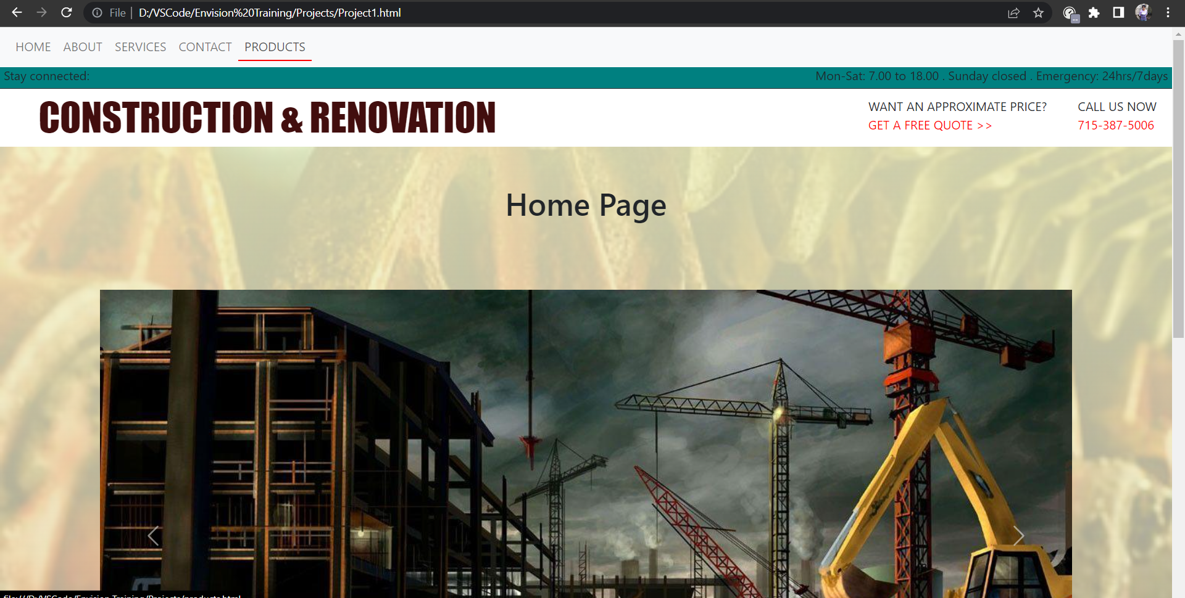
Project Snapshots

Slide 12
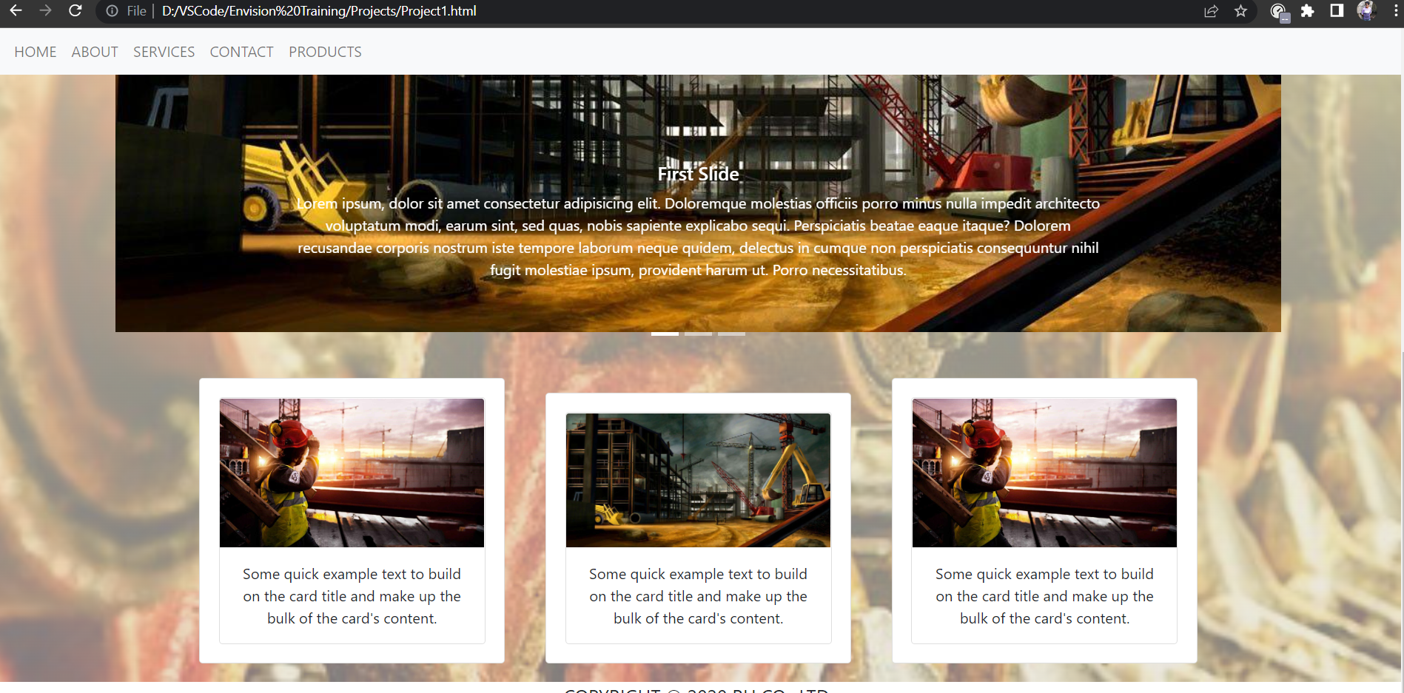
Project Snapshots

Slide 13
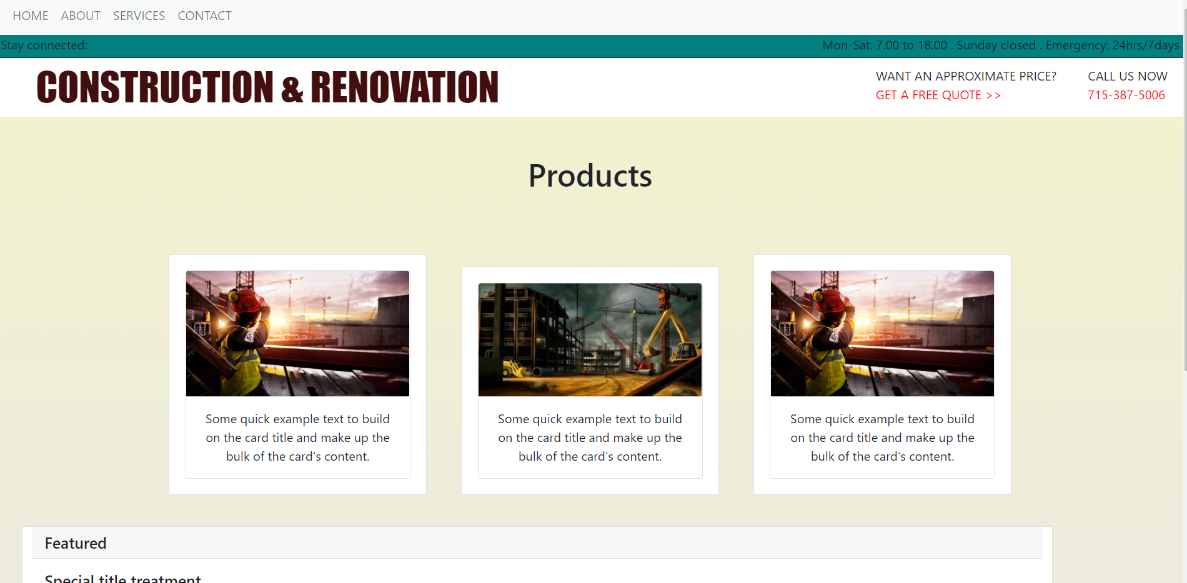
Project Snapshots

Slide 14
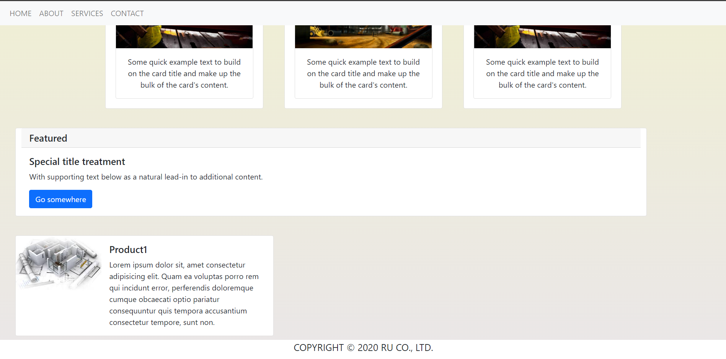
Project Snapshots

